Slide 1

Page Object Model - 16
Orion Innovation
Company Overview

Slide 2
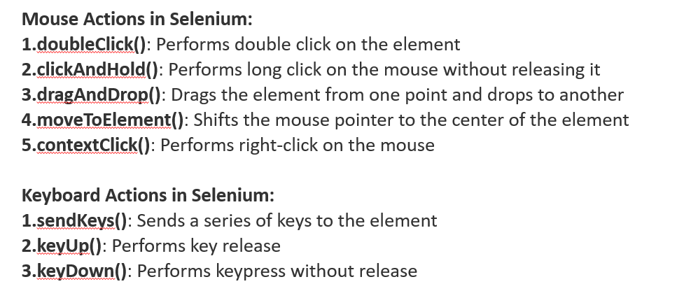
Previous Lesson’s Highlights
ACTIONS
Actions action = new Actions(driver);
action.moveToElement(element).click().perform();
Source: [1] Actions Class

Slide 3
Previous Lesson’s Highlights
JavaScriptExecutor
JavascriptExecutor js = (JavascriptExecutor) driver;
// Get value of an input field
WebElement element = driver.findElement(By.id("elementID"));
String value = (String) js.executeScript("return arguments[0].value;", element);
// Scroll down the page by 1000 pixels
js.executeScript("window.scrollBy(0,1000)");
// Click an element using JavaScript
WebElement element = driver.findElement(By.id("elementID")); js.executeScript("arguments[0].click();", element);
// Highlight an element
WebElement element = driver.findElement(By.id("elementID")); js.executeScript("arguments[0].style.border='3px solid red'", element);
// Generate Alert Pop Window
js.executeScript("alert(‘hello world’);");
// Refresh the browser window
js.executeScript("location.reload()");
Source: [2] Definition of JavascriptExecutor

Slide 4
Content
Page Object Model (POM)

Slide 5
Effective Framework Design
To create a more useful framework, our primary goal is to store the repetitive tasks and test data used in our tests in pre-prepared files.In this way, we can easily access these data when needed in our tests.
If we need to make a change to the test data, we can update all test cases by simply changing a value in the source file.

Slide 6
PAGE OBJECT MODEL (POM)
Page Object Model, also known as POM, is a design pattern in Selenium that creates an object repository for storing all web elements. It helps reduce code duplication and improves test case maintenance.
Source: [3] Definition of Page Object Model

Slide 7
Properties of the Page Object Model
Representation of Web Pages: Each web page is represented by a Java class. These classes contain the page's components (buttons, text boxes, links, etc.) and their functions.
Abstraction of Page Components: Abstracting page components increases code reusability and simplifies maintenance by simplifying access to test cases.
Reusable Test Methods: It promotes the creation and sharing of reusable test methods.
Easy Code Maintenance: Representing web pages and components facilitates easier maintenance and quicker error detection.
Source: [4] Properties of Page Object Model

Slide 8
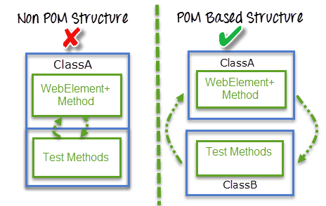
POM Structure
Source: [5] POM Structure

Slide 9
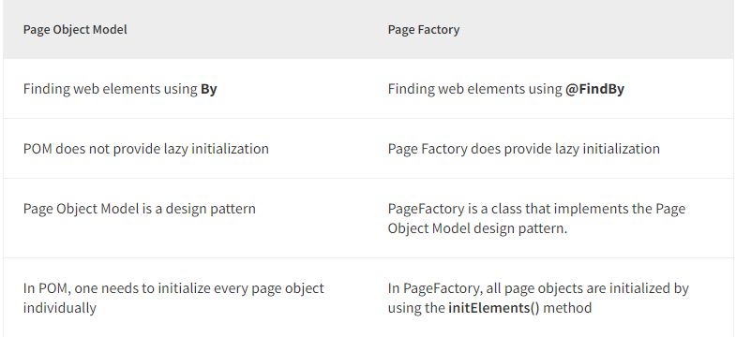
Page Object Model vs Page Factory
Source: [6] Page Object Mode and Page Factory

Slide 10
References
[1] https://www.browserstack.com/guide/action-class-in-selenium
[2] https://www.geeksforgeeks.org/javascriptexecutor-in-selenium/
[3] https://www.browserstack.com/guide/page-object-model-in-selenium
[4] https://chatgpt.com/
[5] https://www.guru99.com/page-object-model-pom-page-factory-in-selenium-ultimate-guide.html
[6] https://www.browserstack.com/guide/page-object-model-in-selenium

Slide 11
Thanks

